Slide 1
Telco Customer Churn Analysis using Machine Learning Techniques
Group 7
Purvi Thakor & Akshay Kamath

Slide 2

ABOUT THE DATA
TYPE OF DATA NEEDED FOR CHURN PREDICTIONS:
Demographic information
Billing and payment information
Services
Contract type and duration
Attribute to predict (Churn=1 means customer leaves, Churn=0 means customer stays)
Source: https://www.ibm.com/communities/analytics/watson-analytics-blog/guide-to-sample-datasets/

Slide 3
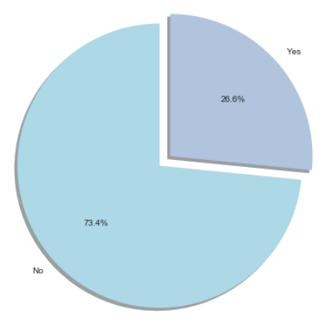
CHURN SPLIT
Out of 7032 customers in the data set 27% of them have stopped using telco’s services.
The rest 73% have stayed loyal to the company!

Slide 4
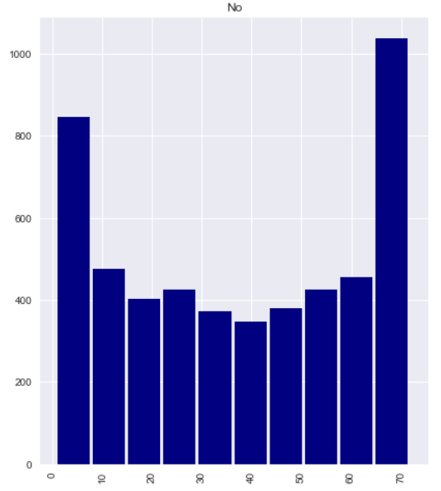
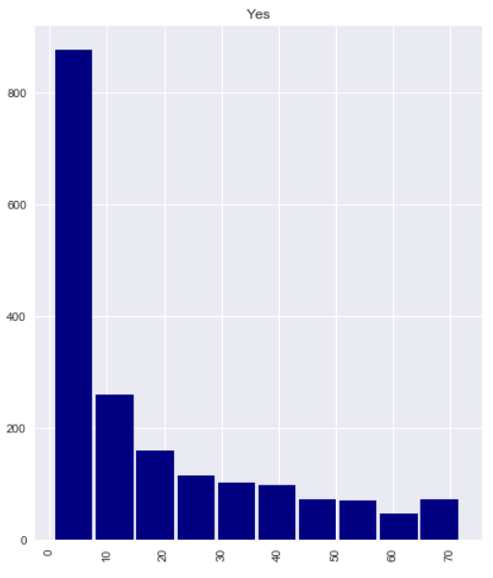
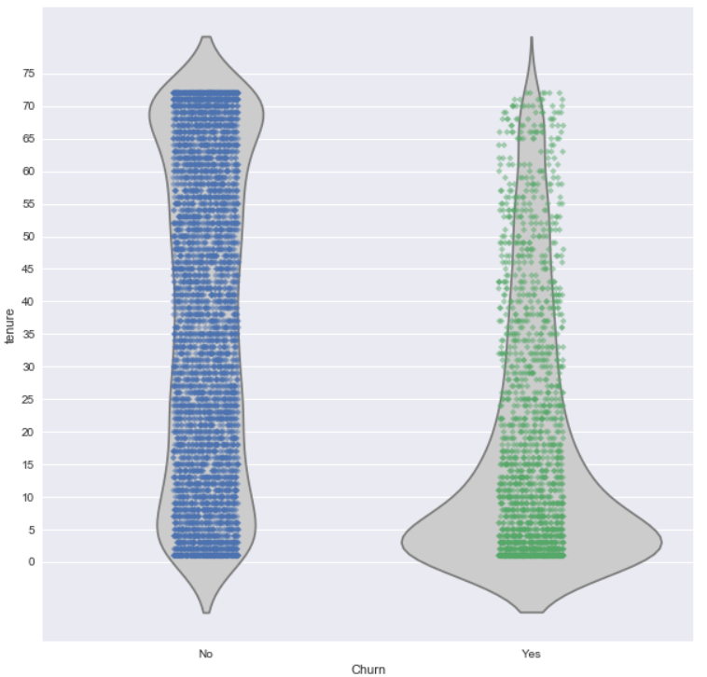
CHURN V/S TENURE

Slide 5
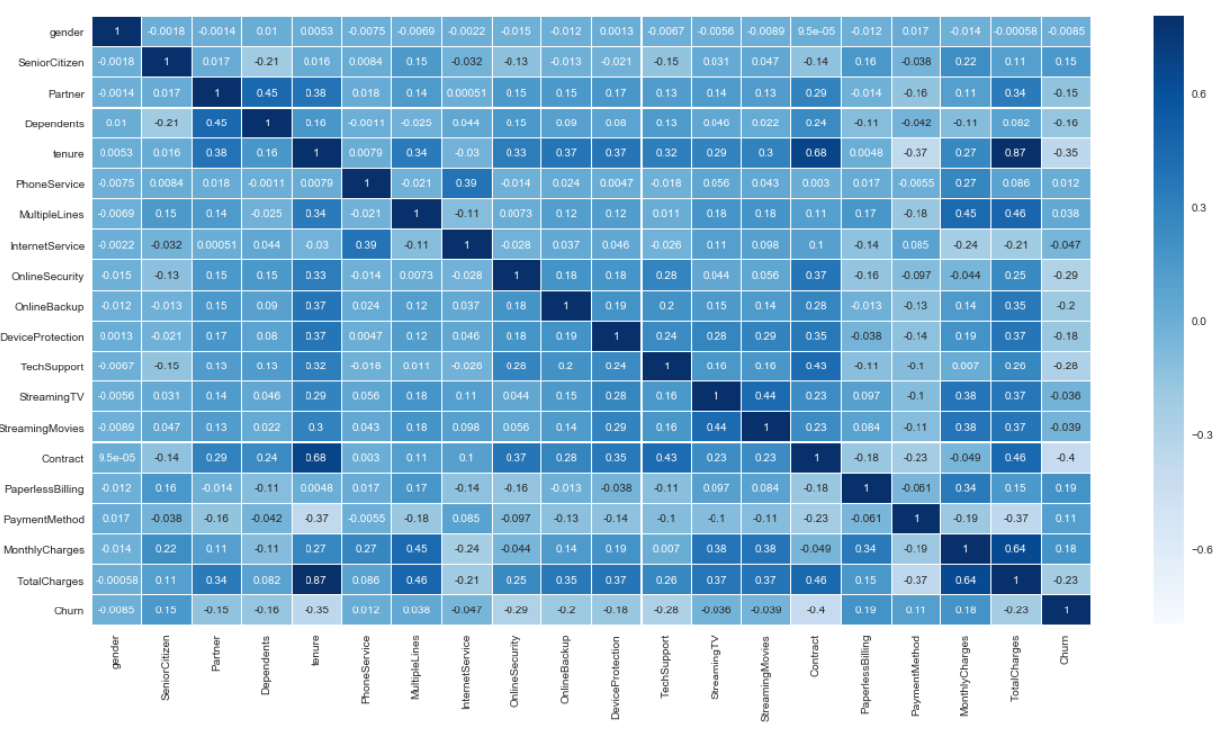
FEATURE CORRELATIONS

Slide 6
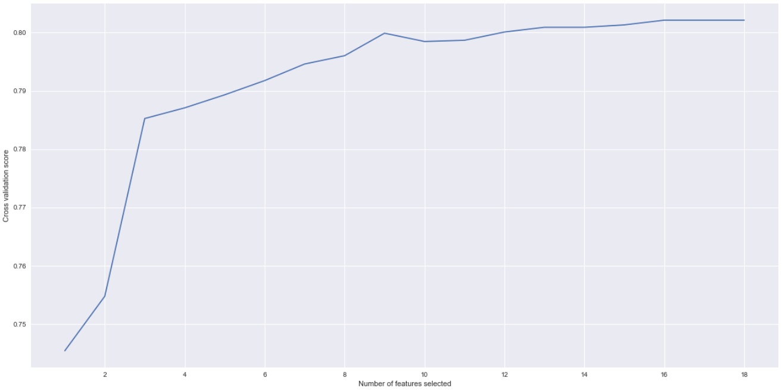
OPTIMAL NUMBER OF FEATURES

Slide 7
MODELS USED FOR CHURN PREDICTONS
Logistic Regression
Random Forest Classifier
Decision Tree Classifier
kNN Classifier
Gaussian Naïve-Bayes Classifier

Slide 8
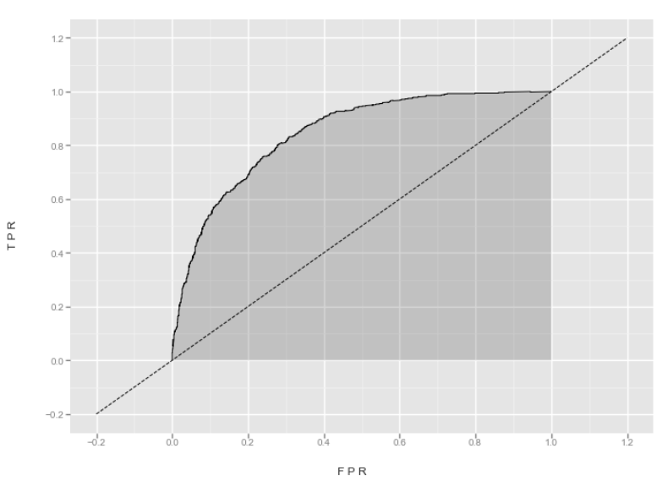
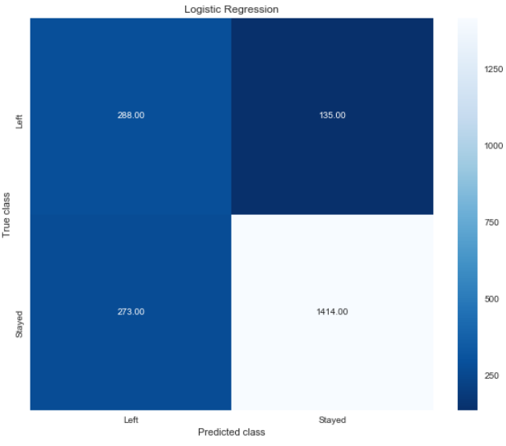
LOGISTIC REGRESSION
AUC = 0.84

Slide 9

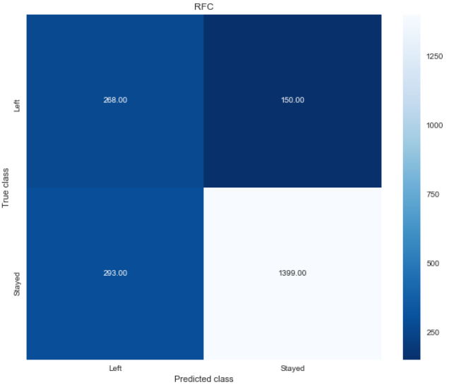
RANDOM FOREST CLASSIFIER
AUC = 0.82

Slide 10
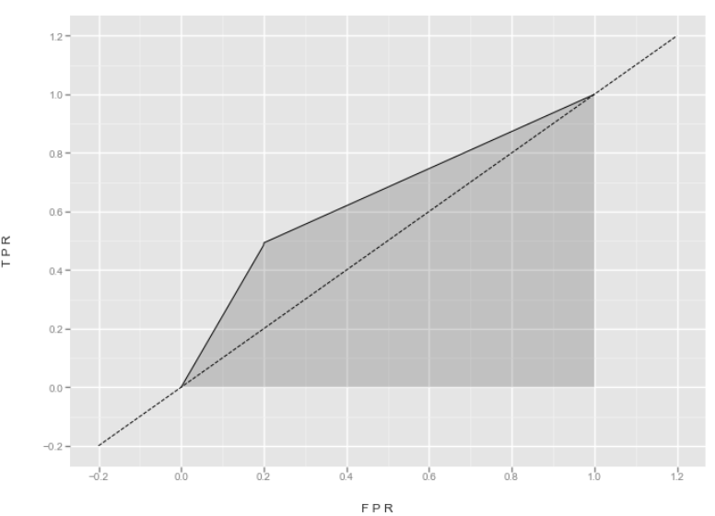
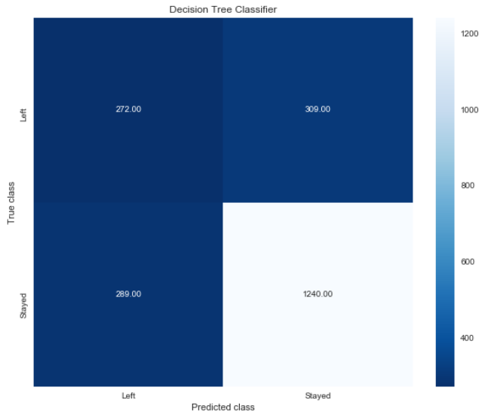
DECISION TREE CLASSIFIER
AUC = 0.65

Slide 11
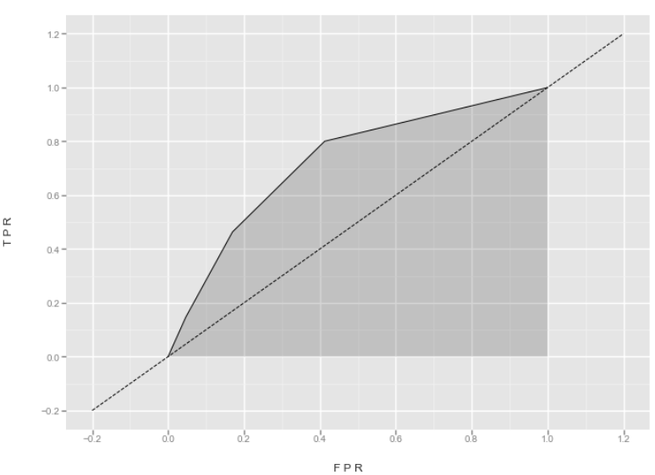
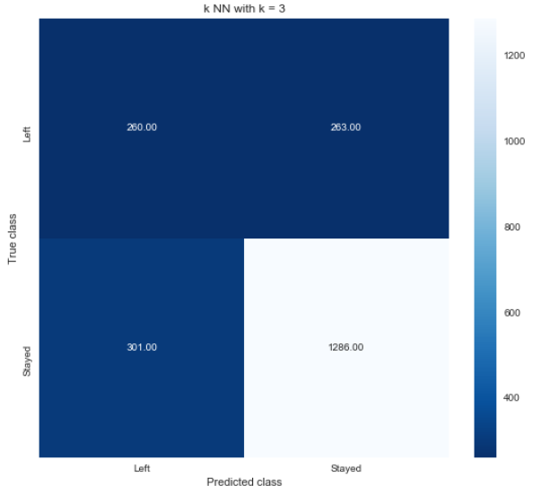
kNN CLASSIFIER (k=3)
AUC = 0.72

Slide 12
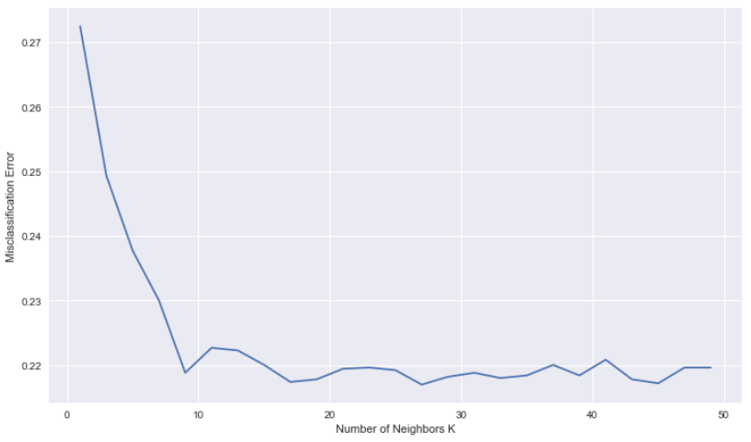
kNN CLASSIFIER – SELECTING OPTIMAL K

Slide 13
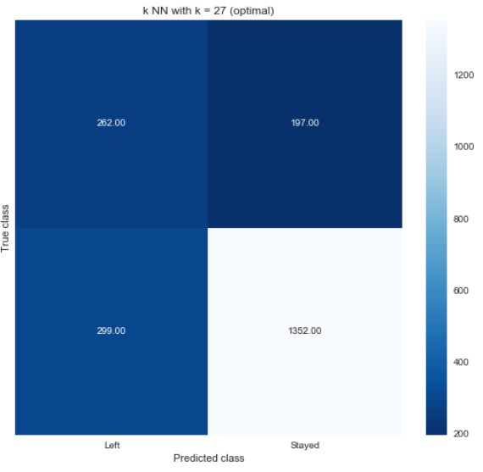
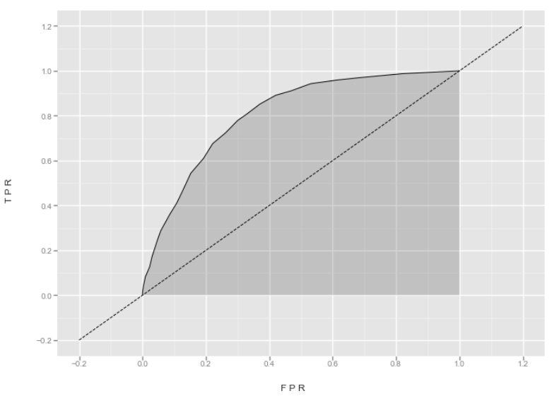
kNN CLASSIFIER (k = 27)
AUC = 0.81

Slide 14
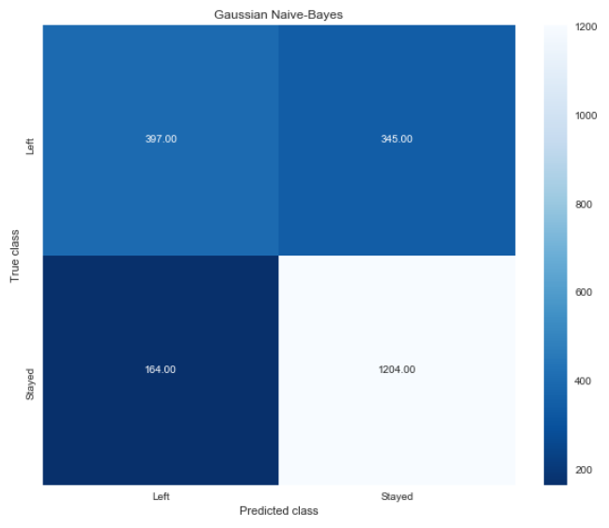
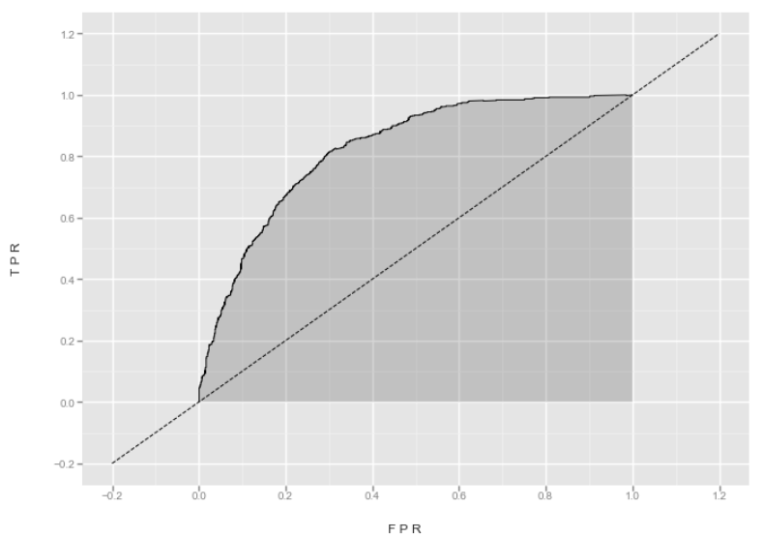
GAUSSIAN NAÏVE-BAYES CLASSIFIER
AUC = 0.82

Slide 15
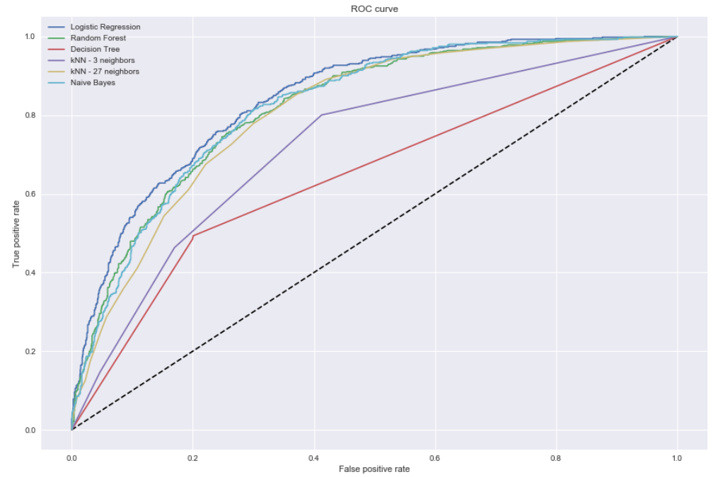
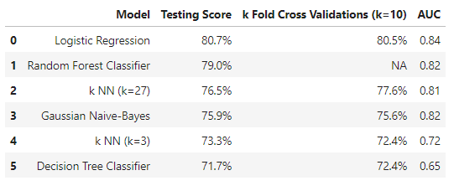
MODEL COMPARISONS

Slide 16
THANK YOU

